Slide 1
Significantly Improved Multi-bit Differentials for Reduced Round Salsa and ChaCha
Arka Rai Choudhuri
Johns Hopkins University
USA
Subhamoy Maitra
Indian Statistical Institute
India
FSE 2017, Tokyo
Notes:
It follows from very simple ideas.

Slide 2
Salsa and ChaCha
ARX based stream ciphers.
Designed by Dan Bernstein.
Salsa accepted into the eStream software portfolio (2007).
ChaCha designed to address some concerns about Salsa (2008).

Slide 3
Motivation
Standardization process for inclusion of cipher suite based on ChaCha20-Poly1305 AEAD in TLS1.3 is almost complete.
Existing cryptanalysis treats ciphers as black-boxes.
Brute force search for multiple components in cryptanalysis.
Notes:
We need to know its security margins.

Slide 4
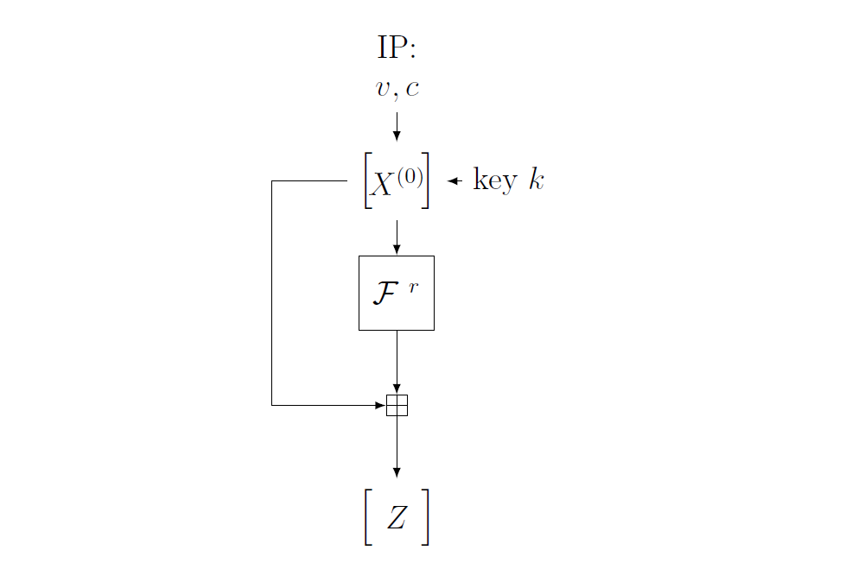
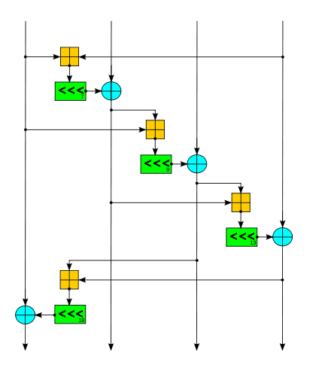
Structure
Easy to implement.
Fast on PCs.
No security guarantees.
https://en.wikipedia.org/wiki/File:Salsa_round_function.svg
Notes:
Rounds are reversible

Slide 5
Non Randomness

Slide 6
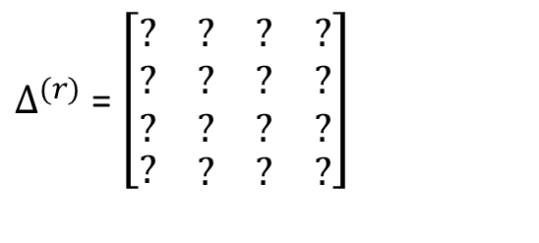
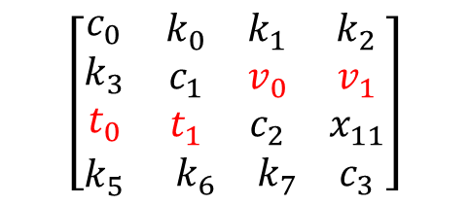
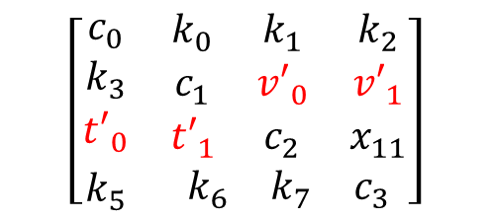
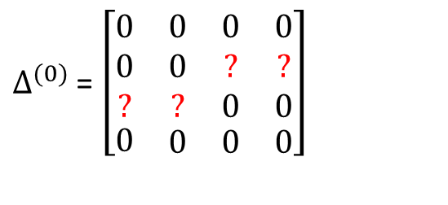
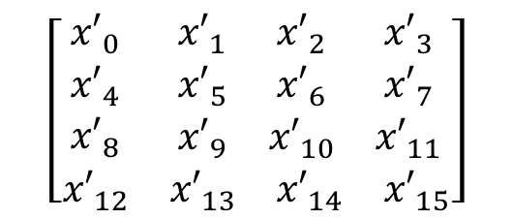
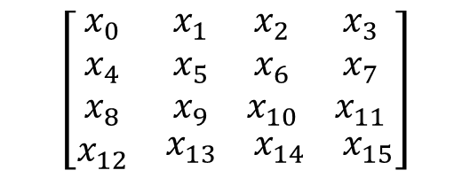
$$\left[\begin{matrix}\begin{matrix}c_{0} \\ k_{3} \\ t_{0}\end{matrix} & \begin{matrix}k_{0} & k_{1} & k_{2} \\ c_{1} & v_{0} & v_{1} \\ t_{1} & c_{2} & x_{11}\end{matrix} \\ k_{5} & \begin{matrix}k_{6} & k_{7} & c_{3}\end{matrix}\end{matrix}\right]$$
$$\left[\begin{matrix}\begin{matrix}x_{0} \\ x_{4} \\ x_{8}\end{matrix} & \begin{matrix}x_{1} & x_{2} & x_{3} \\ x_{5} & x_{6} & x_{7} \\ x_{9} & x_{10} & x_{11}\end{matrix} \\ x_{12} & \begin{matrix}x_{13} & x_{14} & x_{15}\end{matrix}\end{matrix}\right]$$
Salsa^{r}
$$\left[\begin{matrix}\begin{matrix}c_{0} \\ k_{3} \\ {t′}_{0}\end{matrix} & \begin{matrix}k_{0} & k_{1} & k_{2} \\ c_{1} & {v′}_{0} & {v′}_{1} \\ {t′}_{1} & c_{2} & x_{11}\end{matrix} \\ k_{5} & \begin{matrix}k_{6} & k_{7} & c_{3}\end{matrix}\end{matrix}\right]$$
$$\left[\begin{matrix}\begin{matrix}{x′}_{0} \\ {x′}_{4} \\ {x′}_{8}\end{matrix} & \begin{matrix}{x′}_{1} & {x′}_{2} & {x′}_{3} \\ {x′}_{5} & {x′}_{6} & {x′}_{7} \\ {x′}_{9} & {x′}_{10} & {x′}_{11}\end{matrix} \\ {x′}_{12} & \begin{matrix}{x′}_{13} & {x′}_{14} & {x′}_{15}\end{matrix}\end{matrix}\right]$$
Salsa^{r}
$∆^{(0)}$ = $\left[\begin{matrix}\begin{matrix}0 \\ 0 \\ ?\end{matrix} & \begin{matrix}0 & 0 & 0 \\ 0 & ? & ? \\ ? & 0 & 0\end{matrix} \\ 0 & \begin{matrix}0 & 0 & 0\end{matrix}\end{matrix}\right]$
$∆^{(r)}$ = $\left[\begin{matrix}\begin{matrix}? \\ ? \\ ?\end{matrix} & \begin{matrix}? & ? & ? \\ ? & ? & ? \\ ? & ? & ?\end{matrix} \\ ? & \begin{matrix}? & ? & ?\end{matrix}\end{matrix}\right]$
Notes:
Rule out the related key attack.

Slide 7
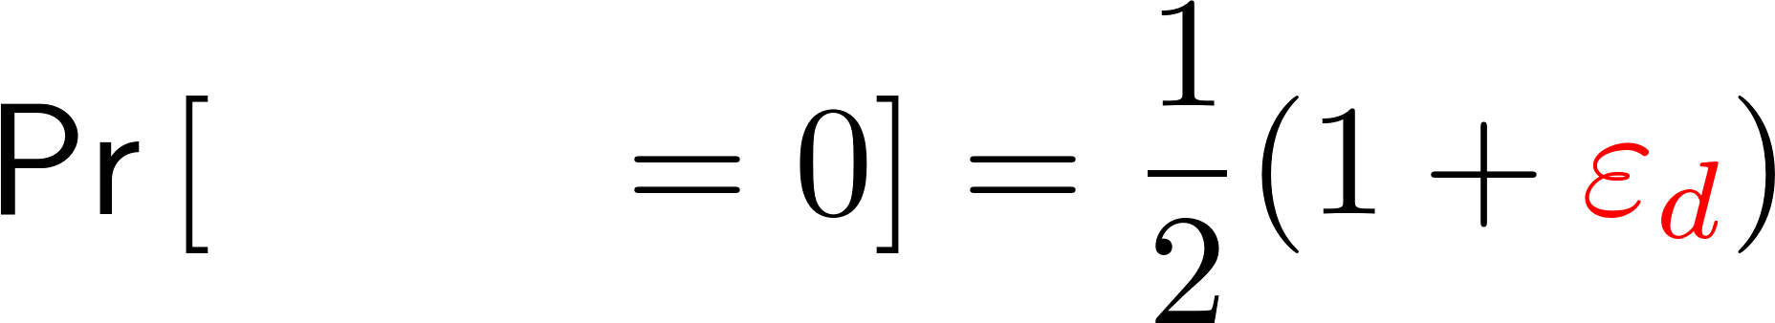
$$\left[\begin{matrix}\begin{matrix}c_{0} \\ k_{3} \\ t_{0}\end{matrix} & \begin{matrix}k_{0} & k_{1} & k_{2} \\ c_{1} & v_{0} & v_{1} \\ t_{1} & c_{2} & x_{11}\end{matrix} \\ k_{5} & \begin{matrix}k_{6} & k_{7} & c_{3}\end{matrix}\end{matrix}\right]$$
$$\left[\begin{matrix}\begin{matrix}x_{0} \\ x_{4} \\ x_{8}\end{matrix} & \begin{matrix}x_{1} & x_{2} & x_{3} \\ x_{5} & x_{6} & x_{7} \\ x_{9} & x_{10} & x_{11}\end{matrix} \\ x_{12} & \begin{matrix}x_{13} & x_{14} & x_{15}\end{matrix}\end{matrix}\right]$$
Salsa^{r}
$$\left[\begin{matrix}\begin{matrix}c_{0} \\ k_{3} \\ {t′}_{0}\end{matrix} & \begin{matrix}k_{0} & k_{1} & k_{2} \\ c_{1} & {v′}_{0} & {v′}_{1} \\ {t′}_{1} & c_{2} & x_{11}\end{matrix} \\ k_{5} & \begin{matrix}k_{6} & k_{7} & c_{3}\end{matrix}\end{matrix}\right]$$
$$\left[\begin{matrix}\begin{matrix}{x′}_{0} \\ {x′}_{4} \\ {x′}_{8}\end{matrix} & \begin{matrix}{x′}_{1} & {x′}_{2} & {x′}_{3} \\ {x′}_{5} & {x′}_{6} & {x′}_{7} \\ {x′}_{9} & {x′}_{10} & {x′}_{11}\end{matrix} \\ {x′}_{12} & \begin{matrix}{x′}_{13} & {x′}_{14} & {x′}_{15}\end{matrix}\end{matrix}\right]$$
Salsa^{r}
$∆^{(0)}$ = $\left[\begin{matrix}\begin{matrix}0 \\ 0 \\ ?\end{matrix} & \begin{matrix}0 & 0 & 0 \\ 0 & ? & ? \\ ? & 0 & 0\end{matrix} \\ 0 & \begin{matrix}0 & 0 & 0\end{matrix}\end{matrix}\right]$
$∆^{(r)}$ = $\left[\begin{matrix}\begin{matrix}? \\ ? \\ ?\end{matrix} & \begin{matrix}? & ? & ? \\ ? & ? & ? \\ ? & ? & ?\end{matrix} \\ ? & \begin{matrix}? & ? & ?\end{matrix}\end{matrix}\right]$

Slide 8
$$\left[\begin{matrix}\begin{matrix}c_{0} \\ k_{3} \\ t_{0}\end{matrix} & \begin{matrix}k_{0} & k_{1} & k_{2} \\ c_{1} & v_{0} & v_{1} \\ t_{1} & c_{2} & x_{11}\end{matrix} \\ k_{5} & \begin{matrix}k_{6} & k_{7} & c_{3}\end{matrix}\end{matrix}\right]$$
$$\left[\begin{matrix}\begin{matrix}x_{0} \\ x_{4} \\ x_{8}\end{matrix} & \begin{matrix}x_{1} & x_{2} & x_{3} \\ x_{5} & x_{6} & x_{7} \\ x_{9} & x_{10} & x_{11}\end{matrix} \\ x_{12} & \begin{matrix}x_{13} & x_{14} & x_{15}\end{matrix}\end{matrix}\right]$$
Salsa^{r}
$$\left[\begin{matrix}\begin{matrix}c_{0} \\ k_{3} \\ {t′}_{0}\end{matrix} & \begin{matrix}k_{0} & k_{1} & k_{2} \\ c_{1} & {v′}_{0} & {v′}_{1} \\ {t′}_{1} & c_{2} & x_{11}\end{matrix} \\ k_{5} & \begin{matrix}k_{6} & k_{7} & c_{3}\end{matrix}\end{matrix}\right]$$
$$\left[\begin{matrix}\begin{matrix}{x′}_{0} \\ {x′}_{4} \\ {x′}_{8}\end{matrix} & \begin{matrix}{x′}_{1} & {x′}_{2} & {x′}_{3} \\ {x′}_{5} & {x′}_{6} & {x′}_{7} \\ {x′}_{9} & {x′}_{10} & {x′}_{11}\end{matrix} \\ {x′}_{12} & \begin{matrix}{x′}_{13} & {x′}_{14} & {x′}_{15}\end{matrix}\end{matrix}\right]$$
Salsa^{r}
$∆^{(0)}$ = $\left[\begin{matrix}\begin{matrix}0 \\ 0 \\ ?\end{matrix} & \begin{matrix}0 & 0 & 0 \\ 0 & ? & ? \\ ? & 0 & 0\end{matrix} \\ 0 & \begin{matrix}0 & 0 & 0\end{matrix}\end{matrix}\right]$
$∆^{(r)}$ = $\left[\begin{matrix}\begin{matrix}? \\ ? \\ ?\end{matrix} & \begin{matrix}? & ? & ? \\ ? & ? & ? \\ ? & ? & ?\end{matrix} \\ ? & \begin{matrix}? & ? & ?\end{matrix}\end{matrix}\right]$
Notes:
We don’t care about what the values or probabilities are at other positions.

Slide 9


Attack idea (for R rounds) [Aumasson et al. 08]
$$ε$$
$$Δ$$
r rounds
Notes:
Key recovery attacks.
Depending on positions where the bias occurs, the key bits can be split as significant and non-significant.
The bias epsilon is used as the distinguishing criteria to obtain the correct significant bits.
Two factors effect the success of the attack. The bias, and the number of significant bits. We want high bias and low significant bits.

Slide 10
Attack idea (for R rounds) [Aumasson et al. 08]
$$ε$$
$$Δ$$
r rounds
significant key bits
non-significant key bits
Notes:
Depending on positions where the bias occurs, the key bits can be split as significant and non-significant.
The bias epsilon is used as the distinguishing criteria to obtain the correct significant bits.
Two factors effect the success of the attack. The bias, and the number of significant bits. We want high bias and low significant bits.

Slide 11
Attack idea (for R rounds) [Aumasson et al. 08]
$$ε$$
$$Δ$$
r rounds
R-r rounds
significant key bits
non-significant key bits
Complexity of attack increases with increase in number of significant bits.
Notes:
Depending on positions where the bias occurs, the key bits can be split as significant and non-significant.
The bias epsilon is used as the distinguishing criteria to obtain the correct significant bits.
Two factors effect the success of the attack. The bias, and the number of significant bits. We want high bias and low significant bits.
Because of the feed forward mechanism I guess the bits to be used.

Slide 12
Salsa
4 rounds
4 rounds
ChaCha
3 rounds
4 rounds
Notes:
It has been studied, and it seems like for known biases the reversing of 4 rounds for both Salsa and ChaCha seems like a road block.
Saturated in both directions. Our focus was on moving the red arrow.

Slide 13
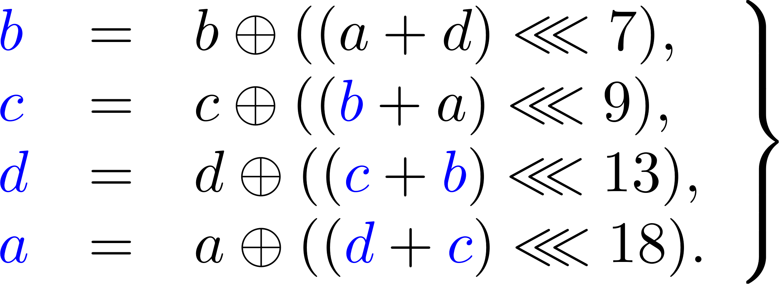

Salsa update function
d
c
d
b
c
d
$$\left[\begin{matrix}\begin{matrix}x_{0} \\ x_{4} \\ x_{8}\end{matrix} & \begin{matrix}x_{1} & x_{2} & x_{3} \\ x_{5} & x_{6} & x_{7} \\ x_{9} & x_{10} & x_{11}\end{matrix} \\ x_{12} & \begin{matrix}x_{13} & x_{14} & x_{15}\end{matrix}\end{matrix}\right]$$
a
b
c
d
a
b
c
a
b
a

Slide 14
Differential-Linear Biases

Slide 15
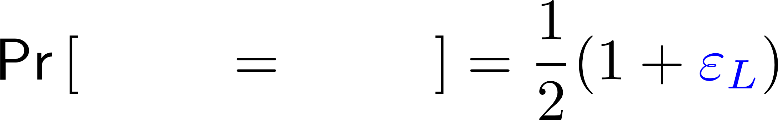
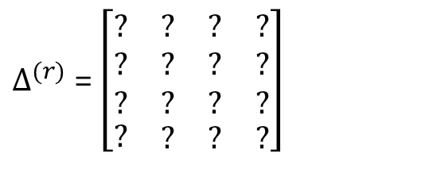
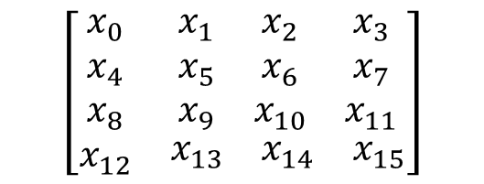
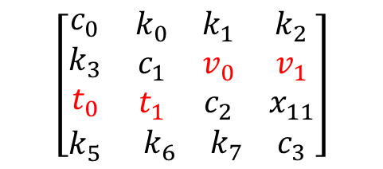
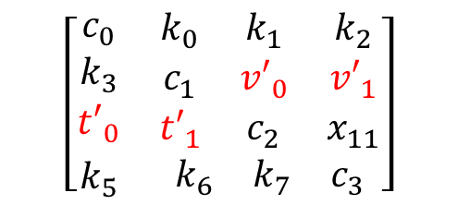
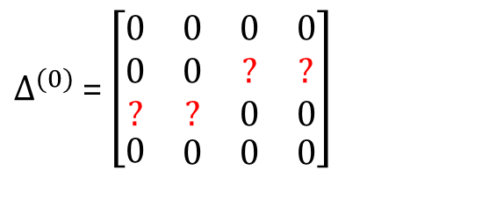
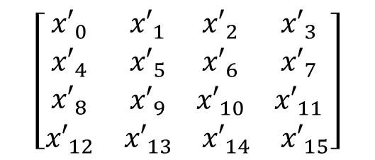
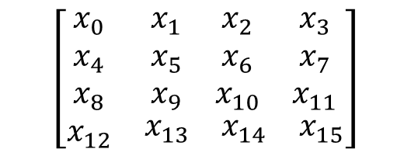
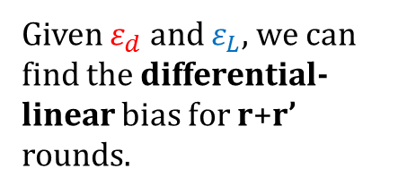
$$\left[\begin{matrix}\begin{matrix}c_{0} \\ k_{3} \\ t_{0}\end{matrix} & \begin{matrix}k_{0} & k_{1} & k_{2} \\ c_{1} & v_{0} & v_{1} \\ t_{1} & c_{2} & x_{11}\end{matrix} \\ k_{5} & \begin{matrix}k_{6} & k_{7} & c_{3}\end{matrix}\end{matrix}\right]$$
$$\left[\begin{matrix}\begin{matrix}x_{0} \\ x_{4} \\ x_{8}\end{matrix} & \begin{matrix}x_{1} & x_{2} & x_{3} \\ x_{5} & x_{6} & x_{7} \\ x_{9} & x_{10} & x_{11}\end{matrix} \\ x_{12} & \begin{matrix}x_{13} & x_{14} & x_{15}\end{matrix}\end{matrix}\right]$$
$$\left[\begin{matrix}\begin{matrix}x_{0} \\ x_{4} \\ x_{8}\end{matrix} & \begin{matrix}x_{1} & x_{2} & x_{3} \\ x_{5} & x_{6} & x_{7} \\ x_{9} & x_{10} & x_{11}\end{matrix} \\ x_{12} & \begin{matrix}x_{13} & x_{14} & x_{15}\end{matrix}\end{matrix}\right]$$
r rounds
r’ rounds
$$\left[\begin{matrix}\begin{matrix}c_{0} \\ k_{3} \\ {t′}_{0}\end{matrix} & \begin{matrix}k_{0} & k_{1} & k_{2} \\ c_{1} & {v′}_{0} & {v′}_{1} \\ {t′}_{1} & c_{2} & x_{11}\end{matrix} \\ k_{5} & \begin{matrix}k_{6} & k_{7} & c_{3}\end{matrix}\end{matrix}\right]$$
$$\left[\begin{matrix}\begin{matrix}{x′}_{0} \\ {x′}_{4} \\ {x′}_{8}\end{matrix} & \begin{matrix}{x′}_{1} & {x′}_{2} & {x′}_{3} \\ {x′}_{5} & {x′}_{6} & {x′}_{7} \\ {x′}_{9} & {x′}_{10} & {x′}_{11}\end{matrix} \\ {x′}_{12} & \begin{matrix}{x′}_{13} & {x′}_{14} & {x′}_{15}\end{matrix}\end{matrix}\right]$$
r rounds
Given $ε_{d}$ and $ε_{L}$, we can find the differential-linear bias for r+r’ rounds.
$∆^{(0)}$ = $\left[\begin{matrix}\begin{matrix}0 \\ 0 \\ ?\end{matrix} & \begin{matrix}0 & 0 & 0 \\ 0 & ? & ? \\ ? & 0 & 0\end{matrix} \\ 0 & \begin{matrix}0 & 0 & 0\end{matrix}\end{matrix}\right]$
$∆^{(r)}$ = $\left[\begin{matrix}\begin{matrix}? \\ ? \\ ?\end{matrix} & \begin{matrix}? & ? & ? \\ ? & ? & ? \\ ? & ? & ?\end{matrix} \\ ? & \begin{matrix}? & ? & ?\end{matrix}\end{matrix}\right]$
Notes:
People have tried various exhaustive searches for differential biases and yielded nothing useful.

Slide 16

Linear approximation with $ε_{L}=1$
Let’s look at the Salsa update function again

Slide 17
Let’s look at the Salsa update function again
Notes:
We dislike non-linear operations. And the only one here is the modular addition, so let’s get rid of it. We know that we can blindly get rid of it of the modular addition in the Least Significant Bit.

Slide 18
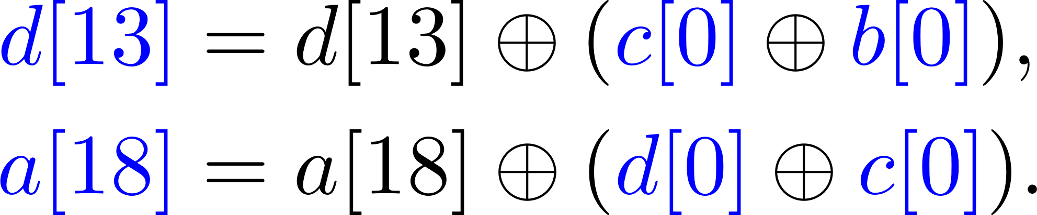
Get rid of the carry.

Slide 19
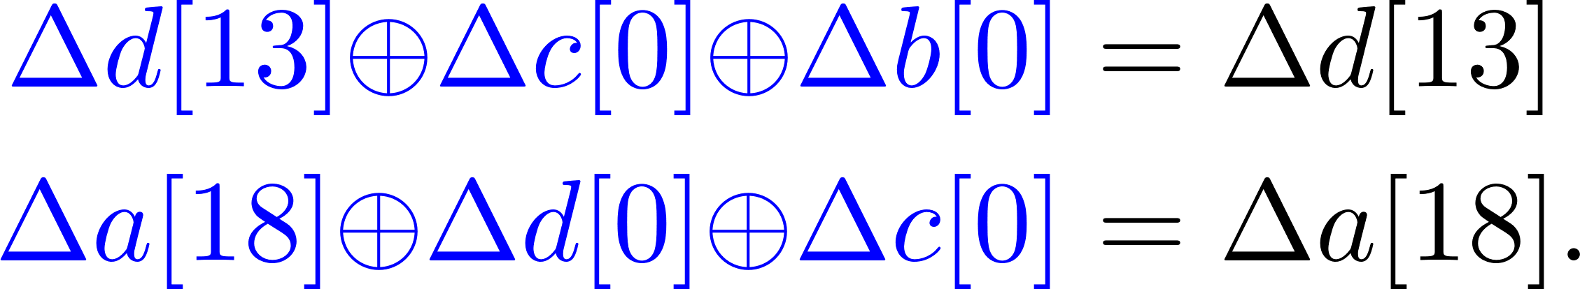
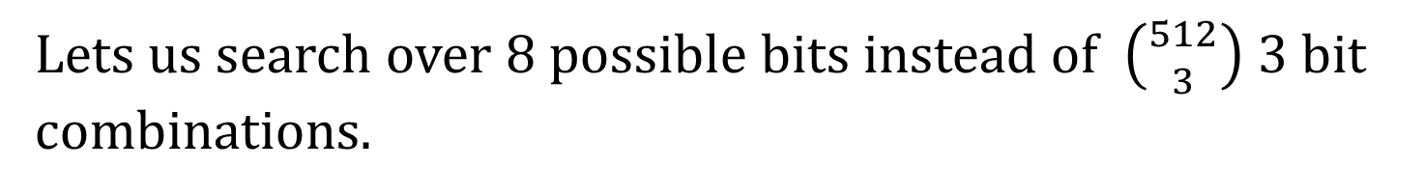


Move things around, from the linearity of XOR
$$ε$$
$$ε$$
Lets us search over 8 possible bits instead of $\left({512 \atop 3}\right)$ 3 bit combinations.
Notes:
Over only a single bit input differential. So 128*8 combinations of ID/OD to get best possible biases.

Slide 20
Similar idea for ChaCha, but involves more bits because of a more involved state update function.
“Unlike Salsa20, our exhaustive search showed no bias in 4-round ChaCha, be it with one, two, or three target output bits.”
Notes:
4 and 5 bit combinations give us high biases.

Slide 21
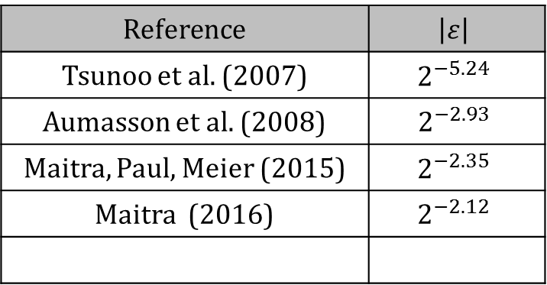
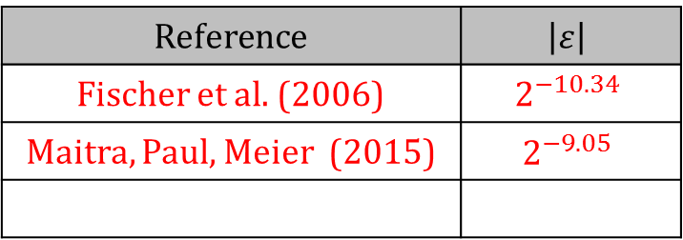
Salsa
Reference | $$\left|ε\right|$$
Tsunoo et al. (2007) | $$2^{−5.24}$$
Aumasson et al. (2008) | $$2^{−2.93}$$
Maitra, Paul, Meier (2015) | $$2^{−2.35}$$
Maitra (2016) | $$2^{−2.12}$$
Reference | $$\left|ε\right|$$
Fischer et al. (2006) | $$2^{−10.34}$$
Maitra, Paul, Meier (2015) | $$2^{−9.05}$$
5 rounds
4 rounds
Notes:
Since there are no know single bit biases for 5 rounds for Salsa and 4 rounds for ChaCha respectively, this doesn’t work beyond round 5.

Slide 22
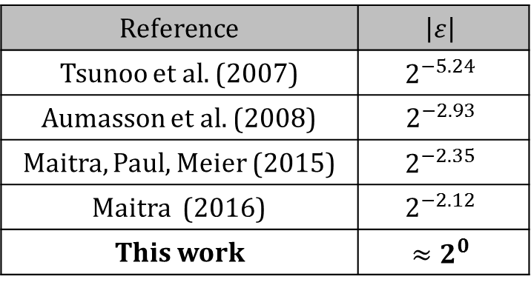
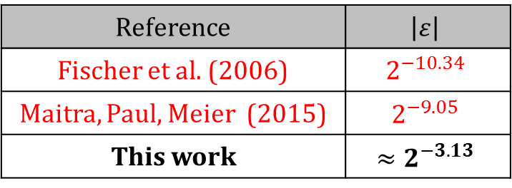
Salsa
Reference | $$\left|ε\right|$$
Tsunoo et al. (2007) | $$2^{−5.24}$$
Aumasson et al. (2008) | $$2^{−2.93}$$
Maitra, Paul, Meier (2015) | $$2^{−2.35}$$
Maitra (2016) | $$2^{−2.12}$$
This work | $$≈2^{0}$$
Reference | $$\left|ε\right|$$
Fischer et al. (2006) | $$2^{−10.34}$$
Maitra, Paul, Meier (2015) | $$2^{−9.05}$$
This work | $$≈2^{−3.13}$$
5 rounds
4 rounds
Notes:
Since there are no know single bit biases for 5 rounds for Salsa and 4 rounds for ChaCha respectively, this doesn’t work beyond round 5.

Slide 23
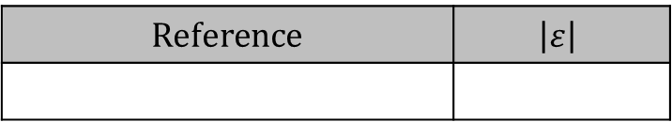
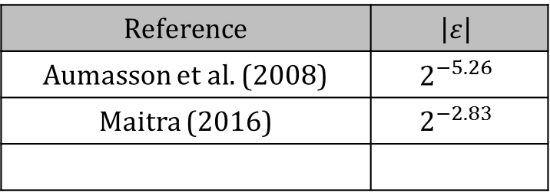
Salsa
Reference | $$\left|ε\right|$$
Tsunoo et al. (2007) | $$2^{−5.24}$$
Aumasson et al. (2008) | $$2^{−2.93}$$
Maitra, Paul, Meier (2015) | $$2^{−2.35}$$
Maitra (2016) | $$2^{−2.12}$$
This work | $$≈2^{0}$$
Reference | $$\left|ε\right|$$
Fischer et al. (2006) | $$2^{−10.34}$$
Maitra, Paul, Meier (2015) | $$2^{−9.05}$$
This work | $$≈2^{−3.13}$$
5 rounds
4 rounds
ChaCha
Reference | $$\left|ε\right|$$
Aumasson et al. (2008) | $$2^{−5.26}$$
Maitra (2016) | $$2^{−2.83}$$
Reference | $$\left|ε\right|$$
4 rounds
3 rounds
Notes:
Since there are no know single bit biases for 5 rounds for Salsa and 4 rounds for ChaCha respectively, this doesn’t work beyond round 5.

Slide 24
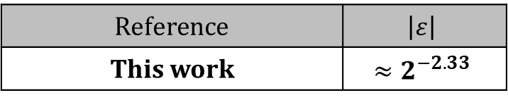
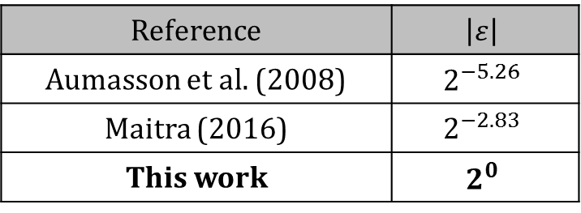
Salsa
Reference | $$\left|ε\right|$$
Tsunoo et al. (2007) | $$2^{−5.24}$$
Aumasson et al. (2008) | $$2^{−2.93}$$
Maitra, Paul, Meier (2015) | $$2^{−2.35}$$
Maitra (2016) | $$2^{−2.12}$$
This work | $$≈2^{0}$$
Reference | $$\left|ε\right|$$
Fischer et al. (2006) | $$2^{−10.34}$$
Maitra, Paul, Meier (2015) | $$2^{−9.05}$$
This work | $$≈2^{−3.13}$$
5 rounds
4 rounds
ChaCha
Reference | $$\left|ε\right|$$
Aumasson et al. (2008) | $$2^{−5.26}$$
Maitra (2016) | $$2^{−2.83}$$
This work | $$2^{0}$$
Reference | $$\left|ε\right|$$
This work | $$≈2^{−2.33}$$
4 rounds
3 rounds
Notes:
Since there are no know single bit biases for 5 rounds for Salsa and 4 rounds for ChaCha respectively, this doesn’t work beyond round 5.
4 round and 3 round respectively are only semi-interesting

Slide 25

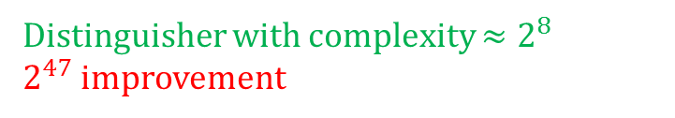
Salsa
Reference | $$\left|ε\right|$$
Tsunoo et al. (2007) | $$2^{−5.24}$$
Aumasson et al. (2008) | $$2^{−2.93}$$
Maitra, Paul, Meier (2015) | $$2^{−2.35}$$
Maitra (2016) | $$2^{−2.12}$$
This work | $$≈2^{0}$$
Reference | $$\left|ε\right|$$
Fischer et al. (2006) | $$2^{−10.34}$$
Maitra, Paul, Meier (2015) | $$2^{−9.05}$$
This work | $$≈2^{−3.13}$$
5 rounds
Distinguisher with complexity $≈2^{8}$
$2^{47}$ improvement
4 rounds
ChaCha
Reference | $$\left|ε\right|$$
Aumasson et al. (2008) | $$2^{−5.26}$$
Maitra (2016) | $$2^{−2.83}$$
This work | $$2^{0}$$
Reference | $$\left|ε\right|$$
This work | $$≈2^{−2.33}$$
4 rounds
Distinguisher with complexity $≈2^{6}$
3 rounds
Notes:
Since there are no know single bit biases for 5 rounds for Salsa and 4 rounds for ChaCha respectively, this doesn’t work beyond round 5.
4 round and 3 round respectively are only semi-interesting
Admittedly the improved attack on Salsa was for a key recovery.

Slide 26
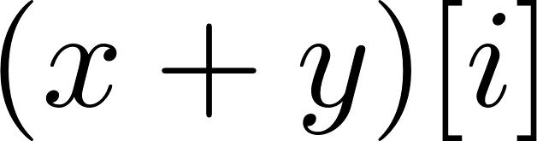

Linear approximation with $ε_{L}<1$
Notes:
The case of using only the LSB to get rid of non-linearity is very restrictive, so we use some known results of linear approximation to attempt to go beyond extending a single round.

Slide 27
Combination of 19 bits from the subsequent round
Notes:
We don’t rely on any independence assumptions.

Slide 28
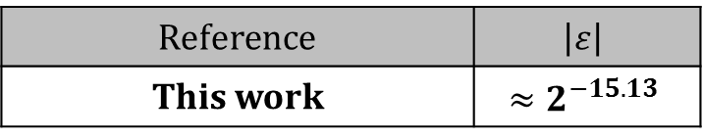
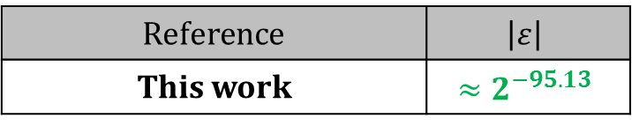
Salsa
Reference | $$\left|ε\right|$$
This work | $$≈2^{−15.13}$$
Reference | $$\left|ε\right|$$
This work | $$≈2^{−95.13}$$
6 rounds
7 rounds
Notes:
Green because these are theoretical and can’t be verified. But it still gives the best known attack via a distinguisher for 6 rounds of ChaCha. But we learned yesterday that nobody cares about theoretical results.
Here the epsilon is the overall bias that is the combination of the differential and linear bias.

Slide 29

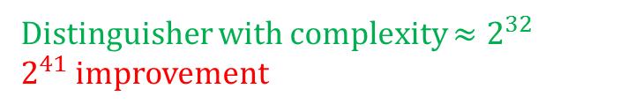
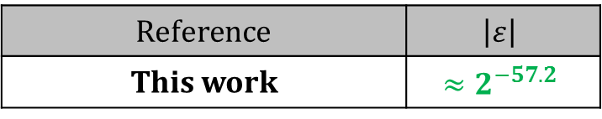
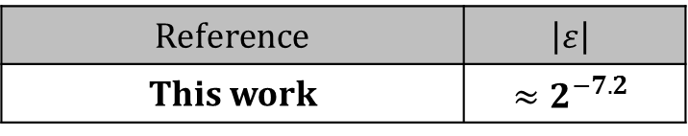
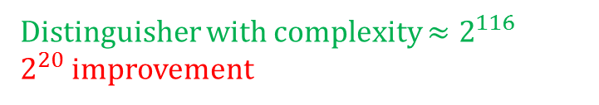
Salsa
Reference | $$\left|ε\right|$$
This work | $$≈2^{−15.13}$$
Reference | $$\left|ε\right|$$
This work | $$≈2^{−95.13}$$
6 rounds
7 rounds
Distinguisher with complexity $≈2^{32}$
$2^{41}$ improvement
ChaCha
Reference | $$\left|ε\right|$$
This work | $${≈2}^{−7.2}$$
Reference | $$\left|ε\right|$$
This work | $$≈2^{−57.2}$$
5 rounds
6 rounds
Distinguisher with complexity $≈2^{16}$
Distinguisher with complexity $≈2^{116}$
$2^{20}$ improvement
Notes:
Green because these are theoretical and can’t be verified. But it still gives the best known attack via a distinguisher for 6 rounds of ChaCha. But we learned yesterday that nobody cares about theoretical results.
Here the epsilon is the overall bias that is the combination of the differential and linear bias.

Slide 30
Implications to the key recovery attack
Notes:
Ad hoc methods before this.
The Aumasson et al paper conjectured that multi bit differentials won’t provide anything useful.

Slide 31
Salsa
4 rounds
4 rounds
6 rounds
But...
Notes:
I assure you the talk would have been titled differently if we could have reverted 4 rounds after a 6 round bias.

Slide 32
Salsa
4 rounds
4 rounds
6 rounds
2 rounds

Slide 33
Salsa
4 rounds
4 rounds
5 rounds
3 rounds
Notes:
But surprisingly

Slide 34
ChaCha
3 rounds
4 rounds
4.5 rounds
2.5 rounds

Slide 35
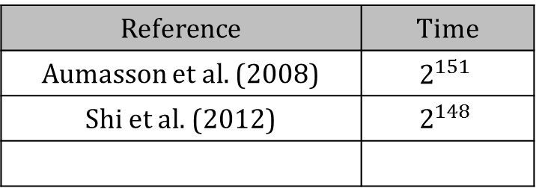
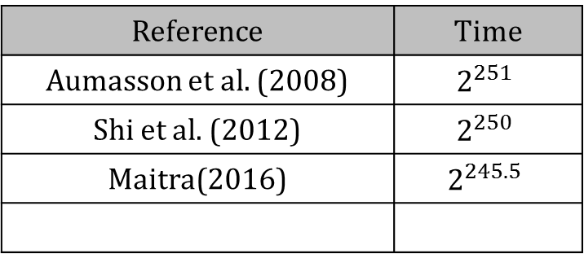
Salsa
Reference | Time
Aumasson et al. (2008) | $$2^{151}$$
Shi et al. (2012) | $$2^{148}$$
Reference | Time
Aumasson et al. (2008) | $$2^{251}$$
Shi et al. (2012) | $$2^{250}$$
Maitra(2016) | $$2^{245.5}$$
7 rounds
8 rounds
Notes:
Since there are no know single bit biases for 5 rounds for Salsa and 4 rounds for ChaCha respectively, this doesn’t work beyond round 5.
4 round and 3 round respectively are only semi-interesting

Slide 36
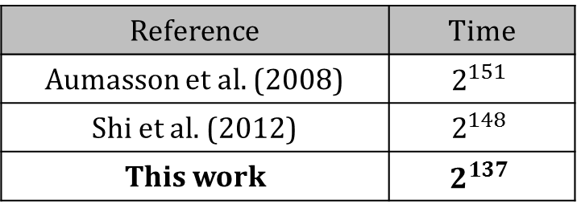
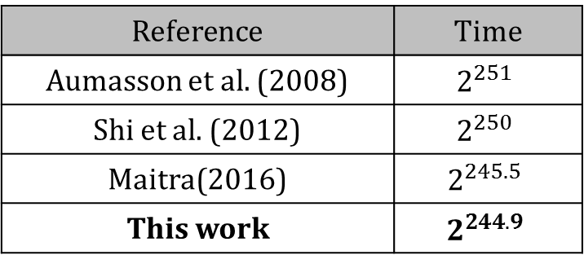
Salsa
Reference | Time
Aumasson et al. (2008) | $$2^{151}$$
Shi et al. (2012) | $$2^{148}$$
This work | $$2^{137}$$
Reference | Time
Aumasson et al. (2008) | $$2^{251}$$
Shi et al. (2012) | $$2^{250}$$
Maitra(2016) | $$2^{245.5}$$
This work | $$2^{244.9}$$
7 rounds
8 rounds

Slide 37


Salsa
Reference | Time
Aumasson et al. (2008) | $$2^{151}$$
Shi et al. (2012) | $$2^{148}$$
This work | $$2^{137}$$
Reference | Time
Aumasson et al. (2008) | $$2^{251}$$
Shi et al. (2012) | $$2^{250}$$
Maitra(2016) | $$2^{245.5}$$
This work | $$2^{244.9}$$
7 rounds
8 rounds
ChaCha
Reference | Time
Aumasson et al. (2008) | $$2^{139}$$
Shi et al. (2012) | $$2^{136}$$
Reference | Time
Aumasson et al. (2008) | $$2^{248}$$
Shi et al. (2012) | $$2^{246.5}$$
Maitra(2016) | $$2^{238.9}$$
6 rounds
7 rounds
Notes:
Since there are no know single bit biases for 5 rounds for Salsa and 4 rounds for ChaCha respectively, this doesn’t work beyond round 5.
4 round and 3 round respectively are only semi-interesting

Slide 38
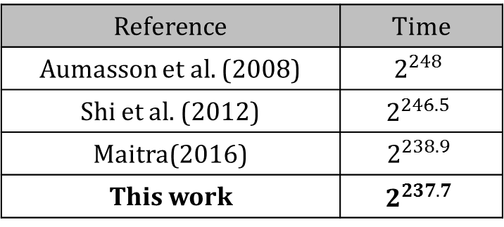

Salsa
Reference | Time
Aumasson et al. (2008) | $$2^{151}$$
Shi et al. (2012) | $$2^{148}$$
This work | $$2^{137}$$
Reference | Time
Aumasson et al. (2008) | $$2^{251}$$
Shi et al. (2012) | $$2^{250}$$
Maitra(2016) | $$2^{245.5}$$
This work | $$2^{244.9}$$
7 rounds
8 rounds
ChaCha
Reference | Time
Aumasson et al. (2008) | $$2^{139}$$
Shi et al. (2012) | $$2^{136}$$
This work | $$2^{127.5}$$
Reference | Time
Aumasson et al. (2008) | $$2^{248}$$
Shi et al. (2012) | $$2^{246.5}$$
Maitra(2016) | $$2^{238.9}$$
This work | $$2^{237.7}$$
6 rounds
7 rounds
Notes:
Note that the result for 7 round Salsa and 6 round ChaCha work with our best biases for 6 and 5 rounds of ChaCha respectively. But we are unfortunately not able to use them for 8 and 7 rounds of Salsa and ChaCha respectively.

Slide 39
Conclusion

Slide 40
We obtain biases in Salsa and ChaCha not obtained for almost a decade. Develop a theory on how to do this.
Improve attacks on some reduced round versions, importantly moving some to practical realms.
A different method to partition the key space could potentially improve our attacks in both complexity and rounds.
(or is this inherent to this kind of cryptanalysis?)
Notes:
Is this inherent?

Slide 41
Thank you. Questions?

Slide 42
References

Slide 43
[C05] Paul Crowley. “Truncated differential cryptanalysis of five rounds of Salsa20". In: IACR Cryptology ePrint Archive 2005 (2005), p. 375. url: http : / /eprint.iacr.org/2005/375.
[FMB⁺06] Simon Fischer, Willi Meier, Come Berbain, Jean-Francois Biasse, and Matthew J. B. Robshaw. “Non-randomness in eSTREAM Candidates Salsa20 and TSC-4". In: Progress in Cryptology - INDOCRYPT 2006, 7th International Conference on Cryptology in India, Kolkata, India, December 11-13, 2006, Proceedings.
[TSK⁺07] Yukiyasu Tsunoo, Teruo Saito, Hiroyasu Kubo, Tomoyasu Suzaki, and Hiroki Nakashima. “Differential Cryptanalysis of Salsa20/8”. 2007. url: http://ecrypt.eu.org/stream/papersdir/2007/010.pdf.
[AFK⁺08] Jean-Philippe Aumasson, Simon Fischer, Shahram Khazaei, Willi Meier, and Christian Rechberger. “New features of Latin dances: analysis of Salsa, ChaCha, and Rumba". In: Fast Software Encryption. Springer. 2008.
[SZF⁺12] Zhenqing Shi, Bin Zhang, Dengguo Feng, and Wenling Wu. “Improved Key Recovery Attacks on Reduced-Round Salsa20 and ChaCha". In: Information Security and Cryptology - ICISC 2012 - 15th International Conference, Seoul, Korea, November 28-30, 2012, Revised Selected Papers.

Slide 44
[MPM15] Subhamoy Maitra, Goutam Paul, and Willi Meier. “Salsa20 Cryptanalysis: New Moves and Revisiting Old Styles". In: WCC 2015, the Ninth International Workshop on Coding and Cryptography, April 13-17, 2015, Paris, France.
[Mai16] Subhamoy Maitra. “Chosen IV cryptanalysis on reduced round ChaCha and Salsa". In: Discrete Applied Mathematics 208 (2016).

Slide 45
Appendix

Slide 46
Timeline
2005
2006
2007
2008
2012
2016
Salsa20 proposed by Dan Bernstein
Six Round Attack [FMB⁺06]
ChaCha20 proposed as improvement over Salsa.
Best known attacks on Salsa20/8 and ChaCha20/7 [Mai16]
Seven Round Attack [TSK⁺07]
Improved attacks on Salsa and ChaCha [SZF⁺12]
Five Round Attack [C05]
Salsa20/12 accepted into eStream
8 Round Attack on Salsa, 7 round attack on ChaCha using PNBs [AFK⁺08]
This Work
Notes:
ChaCha also possibly requires fewer rounds.

