Slide 1

On Ciphers that
Continuously Access
the Non-Volatile Key
Vasily Mikhalev, Frederik Armknecht, Christian Müller
University of Mannheim
March 07, 2017
Fast Software Encryption 2017, Tokyo, Japan

Slide 2
Common Work Flow
Volatile memory, gates, etc..
Non-volatile Memory
Load once
Key
Cipher
Device

Slide 3
New Work Flow
Recent ciphers, e.g. KTANTAN and Sprout consider a different workflow
Volatile memory, gates, etc...
Non-volatile Memory
Continuous
Access
Key
Cipher
Device

Slide 4
Advantages of new Approach
Block Ciphers
  Avoiding using memory for key schedule => saving resources (Area, Power, Energy)
Stream Ciphers
  Secure stream ciphers with shorter internal state [FSE2015] => saving resources
  Higher level of security against certain attacks (e.g. TMDTO)

Slide 5
Examples
Block Ciphers
  KTANTAN
  PRINTcipher
  LED
  Midori
  Other ciphers with precomputed key-schedule
Stream Ciphers
  A2U2
  Sprout
Notes:
Put authors behind cipher names, e.g., Sprout (Armknecht, Mikahelev; 2015)

Slide 6
Impact of the Approach
Papers consider approach of continioulsy accessing NVM as “free“
But how practical is this approach in the real life?
  NVM types and key management?
  Area size?
  Performance?
Notes:
Add a section or slide on „Our contributions“.

Slide 7
Our contributions
Feasibility of this Approach
Reconsideration of Existing Ciphers
Proposal of a New Cipher
New Building Block: Double-Layer LFSR

Slide 8
Contribution 1: Feasibility

Slide 9
NVM Categories and Key Management
Key has to be programmed by manufaturer, e.g. MROM
  Key has to be known before the device is produced ☹
  The approach to be cheap requires that a lot of devices share one key ☹
Key can be set only once, e.g. PROM
  Key has to be set before the device leaves the factory ☹
Key is rewritable, e.g. EEPROM, FLASH
  Flexible key management ☺

Slide 10
Impact on Area Size
Irrespective of the memory type
  The key has to be read at least once in all ciphers
  The logic for this has to be implemented anyhow
  No big difference
  Some small extra area may be needed for synchronization

Slide 11
Impact on Throughput
Memory categories
Key has to be programmed by manufaturer, e.g. MROM
    Instant access, no timing overhead ☺
Key can be set only once, e.g. PROM
  Instant access, no timing overhead ☺
Key is rewritable, e.g. EEPROM, FLASH
  Depends on the concrete type and on the way how the key needs to be accessed !

Slide 12
Standard EEPROM
Common NVM in resource-constrained devices
Different technologies exist
  I²C
  Serial Peripheral Interface (SPI)
  Microwire
  UNI/O

Slide 13
Reading Types
Selective reading
  Read from random address
  More flexibility
  Costly, lower throughput
Sequential reading
  Cyclically reading the next bit
  Less flexible
  Less costly, higher throughput
EEPROM
EEPROM

Slide 14
Contribution 2: Reconsideration of Exiting Ciphers

Slide 15
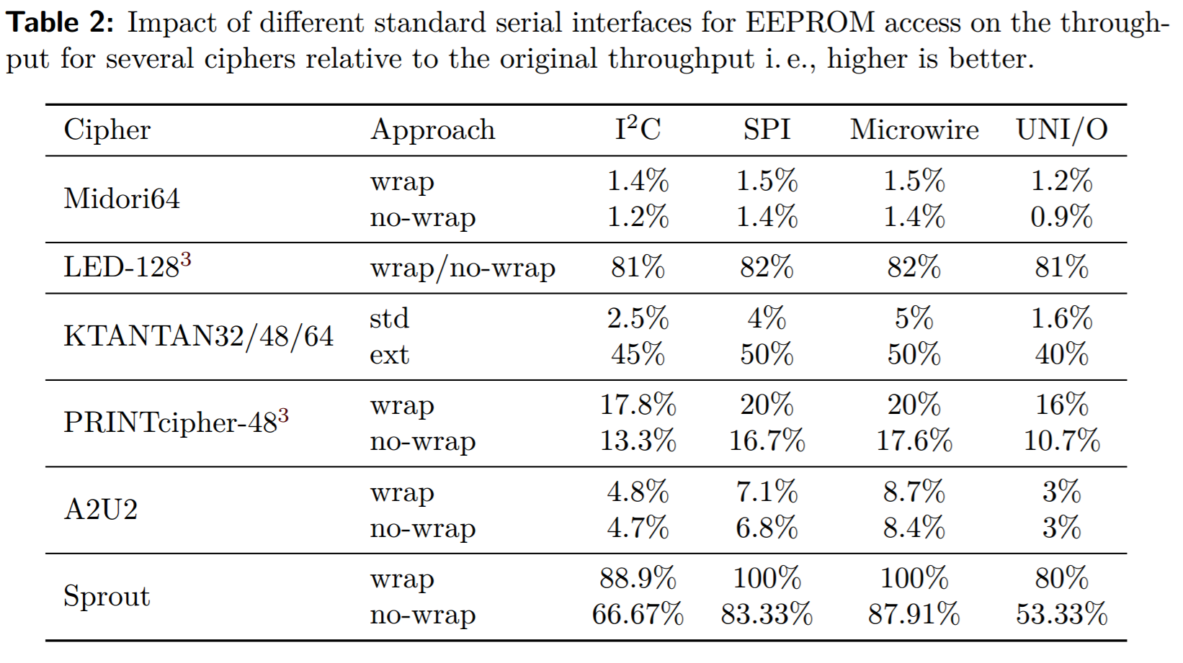
Standard EEPROM and Existing Ciphers

Slide 16
EEPROMs Integrated into ASIC
In theory
  Almost no limitations and hence no influence on throughput
In real life
  Such EEPROMs are usually organized word-wise
  Word size directly influences the area size
  Typical word sizes for low area are 8, 16, or 32 bits
  Bit-by-bit approach can provide low power consumption

Slide 17
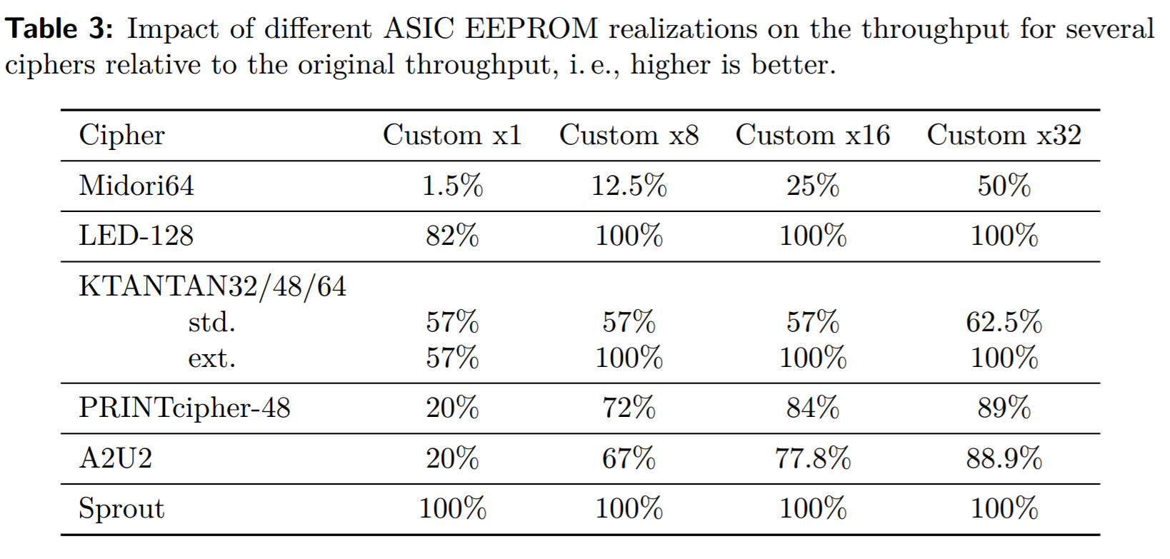
ASIC EEPROM and Existing Ciphers

Slide 18
Summary: Practicability
In general, the approach is practical
No big difference wrt the area size compared with standard approach
For non-rewritable keys (e.g. medical implants) no issues with timing
Otherwise ciphers risk to lose in throughput
Sequential processing of key bits (e.g. LED and Sprout) => almost maximal throughput irrespective of the memory type

Slide 19
Contribution 3: New Design

Slide 20




Problems of Sprout
$$k_{0}^{ }$$
$$k_{1}^{ }$$
…
$$k_{79}^{ }$$
…
Attacks
Round key function
3
$$k_{t}^{∗ }$$
3
29
g
f
6
NLFSR(40 bits)
LFSR (40 bits)
2
7
h
7
Initialization phase
Initialization phase
Notes:
Mention again that this has been published by us at FSE 2015

Slide 21





Sprout: Round Key Function
$$k_{0}^{ }$$
$$k_{1}^{ }$$
…
$$k_{79}^{ }$$
…
Counter
Round t
Select k_{(t mod 80)}
L₄
XOR
$$k_{t}^{∗ }(t≤79)$$
L₂₁
LFSR
L₃₇
AND
$$k_{t}^{∗ }(t>79)$$
N₉
N ₂₀
NLFSR
N₂₉
Notes:
To do: Adapt text format (use same font as on other slides, etc.)

Slide 22
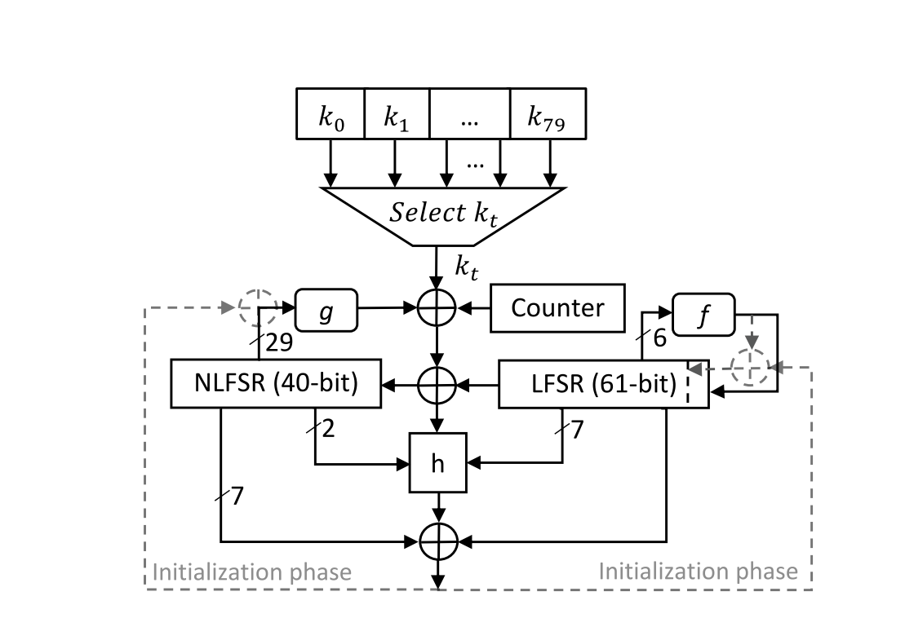
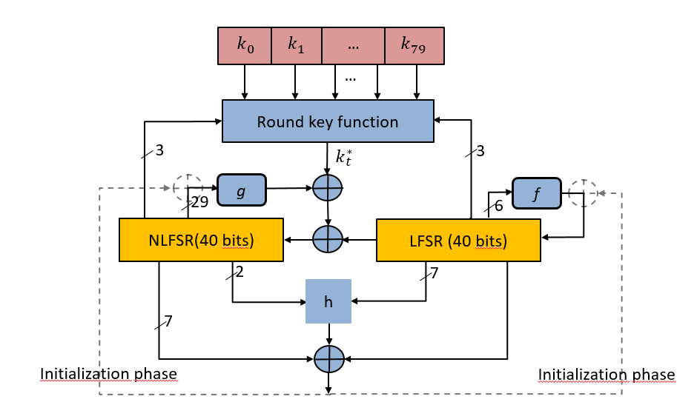
Plantlet

Slide 23
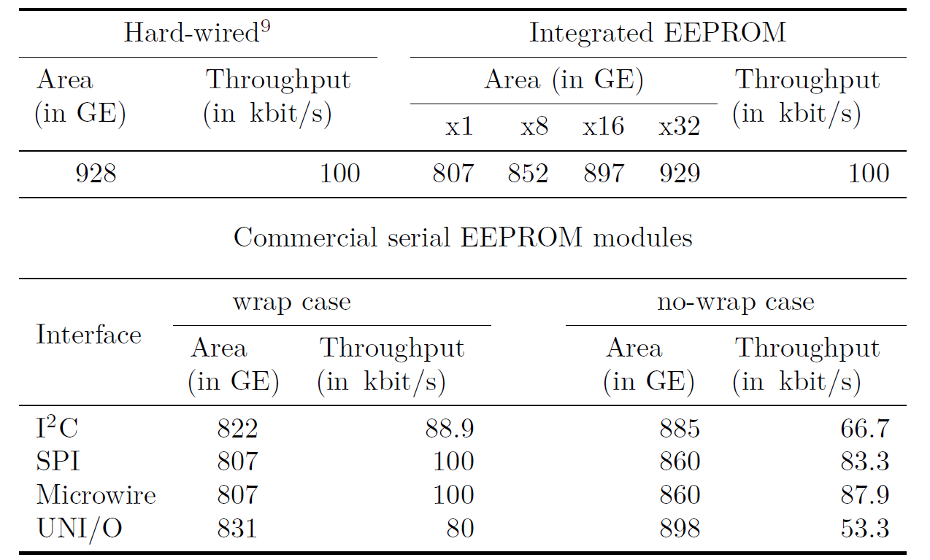

Implementation Results for Plantlet
UMC 0.18 $μm$ process;
Clock frequency 100 kHz

Slide 24
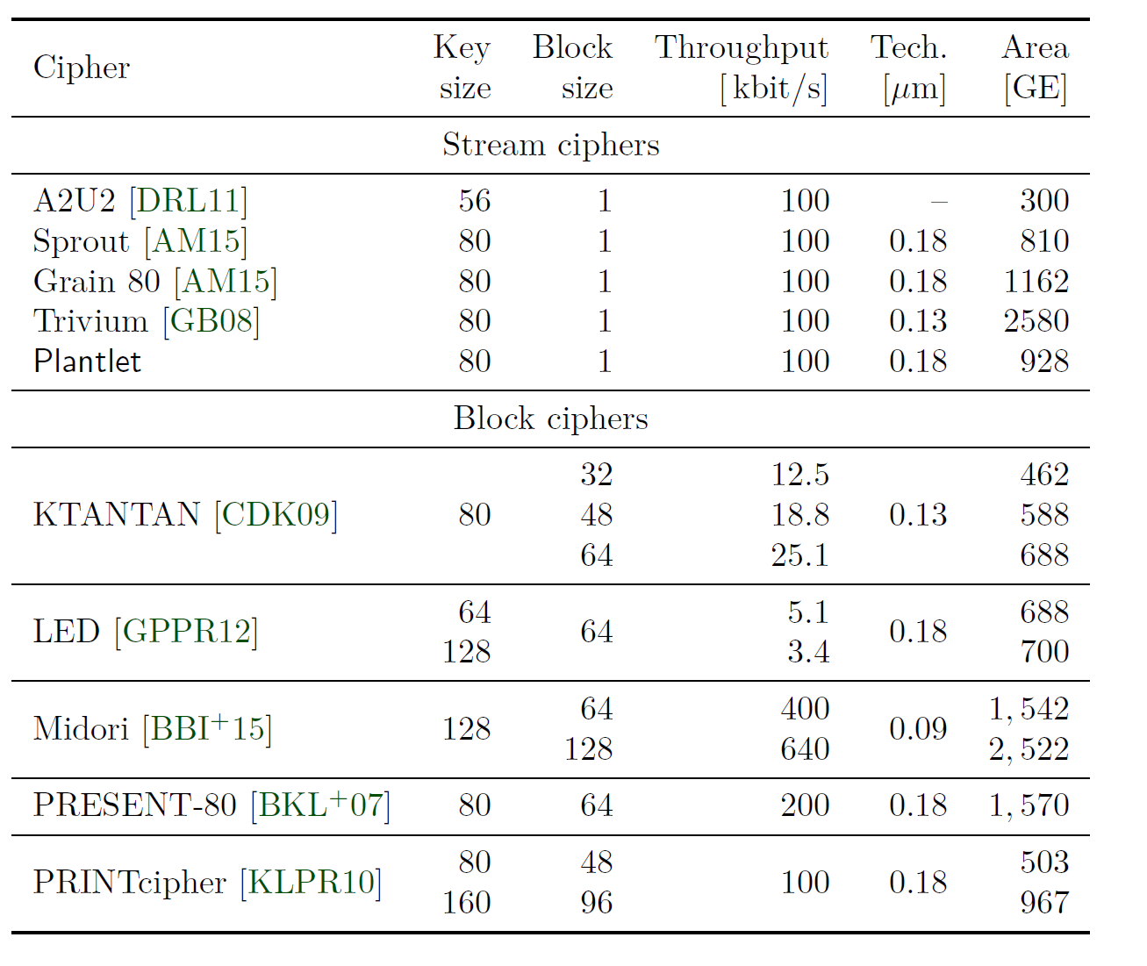
Planlet vs Other Ciphers

Slide 25
Contribution 4: Double-Layer LFSR

Slide 26
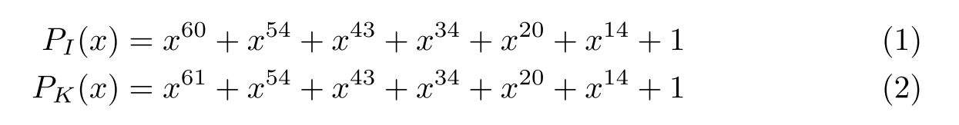
Double-Layer LFSR
Initialization
LFSR of length 60
Keystream
generation
LFSR of length 61
Uses primitive polynomials
Notes:
Add some text on the benefits of this approach (no all zero state, maximum period, area, …)

Slide 27
The end
mikhalev@uni-mannheim.de

